Slide 1
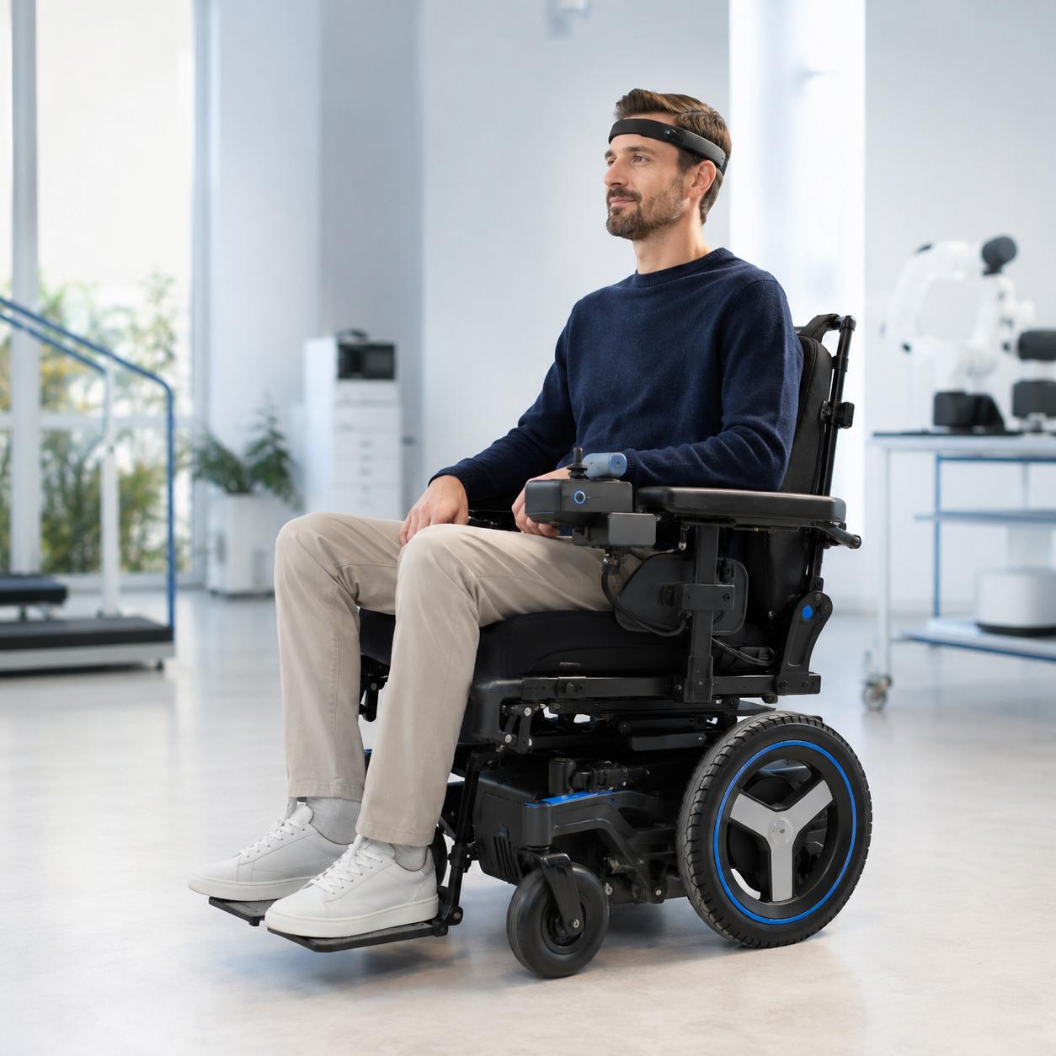
NEXTSYNAPSE
The CHF 1.5M
Productization Plan
From working prototype to a design-frozen, pilot-validated wheelchair control system.
18 MONTHS
Investment case • August 2026
CONCEPT VISUAL — FINAL INDUSTRIAL DESIGN TO BE DEVELOPED
CHF 1.5M PRODUCTIZATION PLAN • 18 MONTHS
01
Notes:
Open with the outcome: CHF 1.5M funds an 18-month, gated productization program. The hero is a concept visualization and must not be presented as a photograph of the existing prototype.
[Sources]
- OpenAI-generated concept visual created for this deck, 25 August 2026.
- Internal NextSynapse planning assumptions supplied by the founder.

Slide 2
NEXTSYNAPSE
The round turns promise into a product asset
TODAY
MONTH 18
Working prototype
Final product v1.0
Core loop: non-invasive EEG signals translated into wheelchair control intent.
Early performance: founder-reported accuracy above 90%; independent replication is still required.
Open risks: safety architecture, user variability, integration, evidence and repeatable manufacturing.
Design freeze with traceable requirements and verified safety controls.
10–15 pilot units plus a costed, supplier-ready manufacturing package.
Pilot evidence, technical documentation and conformity-assessment readiness.
A focused commercial offer for 1–2 wheelchair platforms and partner sites.
The round retires product, safety, user, regulatory and supply-chain risk.
CHF 1.5M PRODUCTIZATION PLAN • 18 MONTHS
02
Notes:
Be explicit that the reported prototype performance is not yet independent evidence. The value creation is the conversion of an experiment into a controlled, reproducible product asset.
[Sources]
- Founder-provided prototype performance claim; independent validation is a planned milestone.
- Internal NextSynapse productization plan.

Slide 3
NEXTSYNAPSE
The final product is a complete control system
V1.0 combines intent decoding, shared control and independent safety — not just an AI model.
FOCUSED V1.0 SCOPE
EEG interface
Signal quality, calibration and user intent input
01
Non-invasive EEG input and rapid per-user calibration.
Shared-control driving with obstacle avoidance and safe stop.
Local, safety-critical operation without a cloud dependency.
Caregiver override, setup workflow and secure audit logs.
Initial support for 1–2 wheelchair platforms.
On-device intent decoder
Real-time inference with confidence gating
02
Independent safety supervisor
Hazard rules, safe stop and caregiver override
03
Shared-control + wheelchair gateway
Obstacle avoidance and platform adapter
04
Setup app + secure logs
Configuration, diagnostics and traceable evidence
Scope discipline makes the 18-month plan credible.
05
CHF 1.5M PRODUCTIZATION PLAN • 18 MONTHS
03
Notes:
Explain the system boundary. The safety supervisor is intentionally independent from the learned intent model. V1.0 is focused on shared control and 1–2 wheelchair platforms; broad autonomy and wide OEM coverage are later expansion paths.
[Sources]
- Internal NextSynapse target architecture; subject to formal hazard analysis and platform agreements.

Slide 4
NEXTSYNAPSE
Five workstreams move in parallel
Each release is gated by safety evidence, usability evidence and traceable design controls.
WORKSTREAM
18-MONTH OUTPUT
01
Product & AI
Stable intent decoding, shared control, calibration and release software
02
Hardware & integration
EEG interface, safety controller, sensors and 1–2 platform adapters
03
Quality & regulatory
QMS, risk file, V&V, usability and technical documentation
04
User validation & pilots
Partner sites, representative users, pilot evidence and support workflow
05
Supply chain & launch
Costed BOM, qualified suppliers, manufacturing package and first offers
CHF 1.5M PRODUCTIZATION PLAN • 18 MONTHS
04
Notes:
Stress that this is not a sequential software project. Regulatory, user and manufacturing evidence must be generated while the product is designed, otherwise rework will consume the schedule.
[Sources]
- Internal NextSynapse workstream plan.

Slide 5
NEXTSYNAPSE
An 18-month roadmap creates four decision gates
PHASE 1
PHASE 2
PHASE 3
PHASE 4
Define & de-risk
Integrated alpha
Verified beta
Freeze & prepare
Intended use
Requirements
Regulatory route
Safety architecture
On-device AI
3–5 alpha units
8–10 beta units
User pilots
Verification evidence
Design freeze
10–15 pilot units
Submission readiness
Months 0–2
CHF 150k
Months 3–6
CHF 400k
Months 7–12
CHF 520k
Months 13–18
CHF 430k
G1
G2
G3
G4
Product definition
Alpha safety proof
Beta + pilot readiness
Design freeze
CHF 1.5M PRODUCTIZATION PLAN • 18 MONTHS
05
Notes:
The four phases compress the work into 18 months without removing gates. Capital and scope should only advance after each exit criterion is met. The phase allocations sum to CHF 1.5M.
[Sources]
- Internal NextSynapse roadmap and budget allocation.

Slide 6
NEXTSYNAPSE
Phase 1 locks the right product before scaling
0–2
WHAT WE COMPLETE
EXIT GATE G1
Intended use, user needs and a focused v1.0 product definition.
System requirements, interfaces and preliminary architecture.
Regulatory qualification/classification and conformity path.
Preliminary hazard analysis and safety case outline.
QMS design controls, evidence plan and data protocol.
Target agreements with two pilot sites and integration partners.
Proceed only if:
MONTHS
Product requirements are approved.
Regulatory route is documented.
Top hazards have defined controls.
Pilot and platform targets are credible.
CHF 150k
Outcome: the team builds one certifiable product — not several competing prototypes.
CHF 1.5M PRODUCTIZATION PLAN • 18 MONTHS
06
Notes:
This is the highest-leverage phase. Formal intended use and system boundary determine the regulatory route, evidence burden and standards. Partner letters of intent are targets, not current commitments.
[Sources]
- European Commission medical device regulations overview: https://health.ec.europa.eu/medical-devices-new-regulations_en
- Swissmedic medical device regulation: https://www.swissmedic.ch/swissmedic/en/home/medical-devices/regulation-of-medical-devices.html
- Internal NextSynapse phase plan.

Slide 7
NEXTSYNAPSE
Phase 2 delivers an integrated alpha
The learned intent model is wrapped in deterministic safety controls and repeatable tests.
BUILD
MONTHS 3–6
EEG pipeline: signal quality, calibration and real-time decoding.
On-device AI: confidence thresholds and reproducible model releases.
Safety supervisor: safe stop, watchdogs and caregiver override.
Shared control: obstacle avoidance and wheelchair gateway.
Evidence engine: HIL simulator, automated tests and secure logs.
CHF 400k
Exit gate G2
Integrated alpha passes the locked bench and hardware-in-the-loop safety protocol.
3–5
≥100
≥90%
integrated alpha units
bench / HIL test hours
locked-protocol accuracy target
CHF 1.5M PRODUCTIZATION PLAN • 18 MONTHS
07
Notes:
These are proposed exit targets, not current results. The performance target must be measured using a locked protocol that specifies commands, users, sessions, signal quality and failure handling.
[Sources]
- Internal NextSynapse phase targets; independent validation required.

Slide 8
NEXTSYNAPSE
Phase 3 proves reliability with real users
USER PILOT
VERIFICATION
Can people use it safely and repeatedly?
Does the beta meet its requirements?
Representative users across two target partner sites.
Calibration, task completion, fatigue, workload and caregiver workflow.
Defined reporting for adverse events, near misses and usability issues.
Software, safety, cyber and wheelchair-interface verification.
EMC and electrical pre-compliance; reliability and misuse scenarios.
Traceability from user need to test result and residual risk.
8–10
12–20
≥500
verified beta units
target users, subject to approvals
cumulative device-hours target
CHF 1.5M PRODUCTIZATION PLAN • 18 MONTHS
08
Notes:
Pilot size and study design are planning targets and depend on ethics/regulatory requirements, site capacity and formal classification. The priority is repeatability and safety evidence, not a marketing demo.
[Sources]
- Swissmedic clinical investigations overview: https://www.swissmedic.ch/clinical-investigations-en
- Internal NextSynapse pilot and verification targets.

Slide 9
NEXTSYNAPSE
Phase 4 freezes the design for repeatable delivery
MONTHS
DESIGN FREEZE
MANUFACTURING PACKAGE
13–18
Released hardware, firmware, AI model, safety rules and configuration.
Costed BOM, drawings, test fixtures, suppliers and build instructions.
CHF 430k
EVIDENCE PACKAGE
COMMERCIAL PACKAGE
V&V report, usability evidence, risk file and technical documentation.
Support process, partner offer, unit economics and first deployment plan.
Exit gate G4
Final v1.0 baseline approved for conformity assessment and controlled pilots.
Next-round scope: high-volume tooling, broad OEM expansion and international commercial rollout.
CHF 1.5M PRODUCTIZATION PLAN • 18 MONTHS
09
Notes:
Define final product precisely: a controlled v1.0 design baseline, pilot units, manufacturing package and evidence package. High-volume manufacturing and broad rollout are deliberately excluded from this round.
[Sources]
- Internal NextSynapse final-product definition and phase plan.

Slide 10
NEXTSYNAPSE
CHF 1.5M concentrates on product and evidence
74%
product, hardware and quality / regulatory evidence
CHF 83k
average planned monthly burn
10–15
final pilot units and build package
Planning allocation — final mix depends on classification, supplier quotations and partner agreements.
CHF 1.5M PRODUCTIZATION PLAN • 18 MONTHS
10
Notes:
The budget is a planning model, not a supplier quote. Seventy-four percent combines core product/software, hardware and quality/regulatory/V&V. The phase plan and category plan both sum to CHF 1.5M.
[Sources]
- Internal NextSynapse budget model prepared for this deck.

Slide 11
NEXTSYNAPSE
A lean core team is amplified by specialists
4–5
CORE OWNERSHIP
CEO / product & accessibility • AI/ML lead • embedded/robotics engineer • full-stack/data engineer
AVERAGE CORE FTEs
A blended European team keeps the runway credible while specialist work is bought when evidence is needed.
QUALITY & EVIDENCE
RA/QA lead • usability/clinical advisor • cybersecurity specialist • accredited test laboratories
DELIVERY PARTNERS
Rehabilitation sites • wheelchair platform partner(s) • industrial design • contract manufacturer
Governance: monthly burn review • gate review at G1–G4 • risk register owned by the product and QA leads
CHF 1.5M PRODUCTIZATION PLAN • 18 MONTHS
11
Notes:
The staffing model assumes a distributed, blended-cost core team and targeted specialist contracts. Exact hires and compensation should be validated before fundraising commitments are made.
[Sources]
- Internal NextSynapse staffing and operating-model assumptions.

Slide 12
NEXTSYNAPSE
Compliance starts on day one
Classification first. Standards drive the requirements and test plan — not late-stage paperwork.
FRAMEWORK
ROLE IN THE PROGRAM
REGULATORY CAVEAT
EU MDR + Swiss MedDO
Qualification, classification, conformity assessment and market access
The final route cannot be assumed today.
ISO 13485
Quality management system and design controls
ISO 14971
Lifecycle hazard analysis, risk controls and residual-risk evidence
It depends on intended purpose, system boundary, supported wheelchair platform and device classification.
IEC 62304 + IEC 62366-1
Software lifecycle and safety-related usability engineering
ISO 7176-14 + ISO 7176-21
Powered-wheelchair control systems and EMC testing
IEC 81001-5-1
Secure health-software development and maintenance lifecycle
Specialist determination is a first-60-day deliverable.
CHF 1.5M PRODUCTIZATION PLAN • 18 MONTHS
12
Notes:
Do not state a device class before intended use and system boundaries are formally assessed. Swissmedic explains that market access requires the applicable conformity assessment, and CE marking is recognized in Switzerland subject to Swiss requirements. As of 1 July 2026, swissdamed device registration requirements apply, with transitional provisions described by Swissmedic. Confirm the latest obligations with a regulatory specialist before execution.
[Sources]
- European Commission — Medical Devices: New regulations: https://health.ec.europa.eu/medical-devices-new-regulations_en
- European Commission — MDCG 2019-11 rev.1 software qualification/classification: https://health.ec.europa.eu/latest-updates/update-mdcg-2019-11-rev1-qualification-and-classification-software-regulation-eu-2017745-and-2025-06-17_en
- Swissmedic — Regulation of medical devices: https://www.swissmedic.ch/swissmedic/en/home/medical-devices/regulation-of-medical-devices.html
- Swissmedic — Market access: https://www.swissmedic.ch/swissmedic/en/home/medical-devices/market-access.html
- Swissmedic — Device registration: https://www.swissmedic.ch/swissmedic/en/home/medical-devices/medizinprodukte-datenbank/produktregistrierung.html
- ISO 13485:2016: https://www.iso.org/standard/59752.html
- ISO 14971:2019: https://www.iso.org/standard/72704.html
- ISO 7176-14:2022: https://www.iso.org/standard/72408.html
- ISO 7176-21:2025: https://www.iso.org/standard/82763.html
- IEC 62304:2006+A1:2015: https://webstore.iec.ch/en/publication/22794
- IEC 62366-1:2015+A1:2020: https://webstore.iec.ch/en/publication/67220
- IEC 81001-5-1:2021: https://webstore.iec.ch/en/publication/63293

Slide 13
NEXTSYNAPSE
Five risks are designed out before launch
RISK
DESIGN RESPONSE
EVIDENCE GATE
User variability
Fast calibration, personalization, signal-quality checks and confidence gating
Locked multi-user protocol
Unintended motion
Independent safety supervisor, safe stop, caregiver override and misuse analysis
Hazard + HIL verification
Platform fragmentation
Start with 1–2 platforms; isolate interfaces behind a modular gateway
Integration verification
Regulatory rework
RA/QA ownership from month one and traceable design controls
G1 route + full V&V
Pilot / supply delay
Early site agreements, pre-selected parts and alternatives for critical components
Site + supplier readiness
CHF 1.5M PRODUCTIZATION PLAN • 18 MONTHS
13
Notes:
These are the five program-level risks most likely to destroy schedule or product credibility. Each risk has a design response and an evidence gate; the register should be reviewed monthly and at every phase gate.
[Sources]
- ISO 14971:2019 risk-management framework: https://www.iso.org/standard/72704.html
- Internal NextSynapse program risk analysis.

Slide 14
NEXTSYNAPSE
Month 18: a financeable product platform
What CHF 1.5M delivers
THE ASK
A controlled v1.0 design freeze.
10–15 pilot units and a manufacturing package.
Verified software, hardware, safety and usability evidence.
A QMS-backed technical file and conformity-assessment readiness.
Pilot partners, support process and a focused commercial offer.
CHF 1.5M
18-month productization round
Target outcome: design-frozen, pilot-validated and ready for the selected conformity-assessment path.
Decision requested: approve the productization round and start Phase 1.
CHF 1.5M PRODUCTIZATION PLAN • 18 MONTHS
14
Notes:
Close with the decision and the precise month-18 asset. Do not imply that high-volume manufacturing or unrestricted market access is included; those depend on the selected conformity path and the next scale-up phase.
[Sources]
- Internal NextSynapse productization plan and funding ask.

